Slide 1
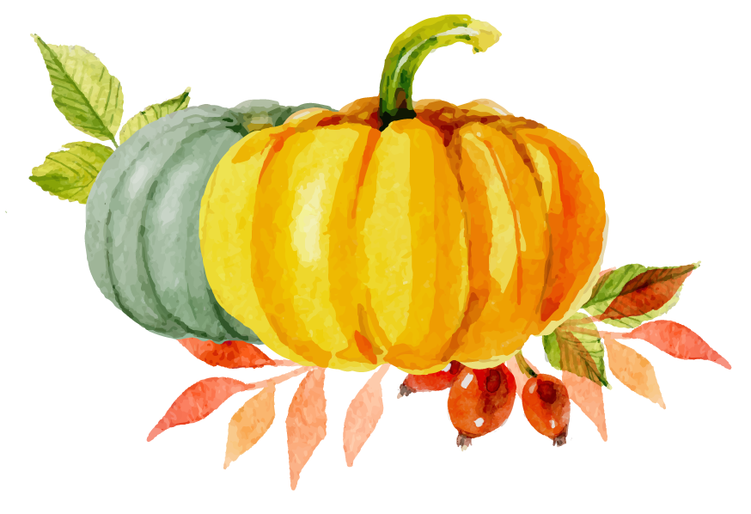
Continuation Writing
I got my head stuck in a pumpkin
2021年1月浙江英语高考真题

Slide 2
阅读下面短文，根据所给情节进行续写，使之构成一个完整的故事。
Pumpkin(南瓜) carving at Halloween is a family tradition. We visit a local farm every October. In the pumpkin field, I compete with my three brothers and sister to seek out the biggest pumpkin. My dad has a rule that we have to carry our pumpkins back home, and as the eldest child I have an advantage - I carried an 85 -pounder back last year.
This year, it was hard to tell whether my prize or the one chosen by my 14-year. Old brother, Jason, was the winner. Unfortunately we forgot to weigh them before taking out their insides, but I was determined to prove my point. All of us were hard at work at the kitchen table, with my mom filming the annual event. I'm unsure now why I thought forcing my head inside the pumpkin would settle the matter,but it seemed to make perfect sense at the time.
With the pumpkin resting on the table,hole uppermost,I bent over and pressed my head against the opening.At first I got jammed just above my eyes and then,as

Slide 3
I went on with my task,unwilling to quit,my nose briefly prevented entry. Finally I managed to put my whole head into it，like a cork（软木塞）forced into a bottle.I was able to straighten up with the huge pumpkin resting on my shoulders.
My excitement was short-lived.The pumpkin was heavy. "I'm going to set it down, now,"I said,and with Jason helping to support its weight,I bent back over the table to give it somewhere to rest. It was only when I tried to remove my head that I realized getting out was going to be less straightforward than getting in.When I pulled hard,my nose got in the way.I got into a panic as I pressed firmly against the table and moved my head around trying to find the right angle,but it was no use."I can't get it out!"I shouted,my voice sounding unnaturally loud in the enclosed space.
Para.1 I was stuck for five or six minutes though it felt much longer.______
Para.2 That video was posted online the Monday before Halloween._______

Slide 4
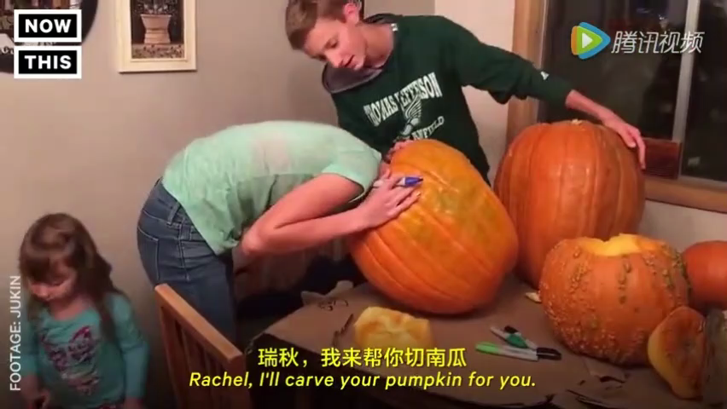
Read the story
Get the main idea (把握故事梗概)
at Halloween
when
where
in the kitchen
?
Story
Jason
dad
mom
I
how
who
why
what
to prove my point as a winner of the biggest pumpkin
I got my head stuck in a pumpkin

Slide 5
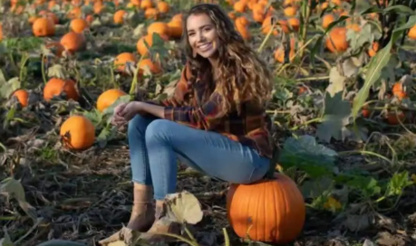
Read the characters
Know the main characters (明确主要人物)
dad
I
Jason
mom
makes it a rule to bring home the biggest pumpkin at Halloween.
the eldest child
have an advantage--I carried an 85-pounder back last year
unwilling to quit
my 14-year-old brother
filming the annual event

Slide 6
文本理解:
Nervous/Worried
Climax para4
I failed to get my head out of the pumpkin after several failed attempts.
Proud
Rising Action para3
I managed to put my head into the hollow pumpkin, feeling proud.
Falling Action
Para1: I was stuck for five or six minutes though it felt much longer.
?
Background/Beginning
para1-2
We seek out the biggest pumpkin for the Halloween every year.
Resolution
Para2: That video was posted online the Monday before Halloween
Excited
Story Mountain故事山
?

Slide 7
情节构思:
Paragraph 1:
I was stuck for five or six minutes though it felt much longer.
Paragraph 2:
That video was posted the Monday before Halloween.
1.How did I feel while stuck in the pumpkin?
2.How did I get my head out?
3.How did I feel afterwards?
Who shot the video/ filmed the event?(前文)
What was the video about?
1.How widely was the video shared online?
2.How did the family members react to it?
3.My reflections.

Slide 8
情节构思:
Paragraph 1: I was stuck for five or six minutes though it felt much longer.
1.How did I feel while stuck in the pumpkin?
2.How did I get my head out?
Regretful: How I wished I had not acted so foolishly, making myself a laughing stock of my family.
Shameful: While stuck in the pumpkin, I could well imagine how they would look when my head came out.
Jason rushed to Dad for help. Dad carefully cut the pumpkin open and helped my head out.
Jason’s mind worked fast and he came up with an idea to helped me out. After what seemed like a century, a bright world came into my sight again.
Jason and Dad worked together, tearing pumpkin into two.

Slide 9
情节构思:
Paragraph 1: I was stuck for five or six minutes though it felt much longer.
Paragraph 2: That video was posted the Monday before Halloween.
3.How did I feel afterwards?
I breathed a sigh of relief. But with the messy hair, I stood there, as if the whole world were looking at me.
When I realized that Mother was still shooting and would upload it online, I rushed for the camera in her hand.
1.How widely was the video shared online?
Go viral: Many likes, funny comments
Immediately become a hit
Out of curiosity, people came to our house to take photos with the prized pumpkin
Become sort of a celebrity, easily recognized in public places

Slide 10
情节构思:
Paragraph 2:
That video was posted the Monday before Halloween.
2.How did the family members react to it?
3.My reflections.
Jason: delighted that he became famous overnight
Mother: could never have imagined that her video could receive so many page views and thus grew even crazier about shooting videos.
Dad: occasionally joked about my embarrassment
Though feeling a bit embarrassed, I felt a stronger family bond – a family surrounded by love and fun.
Bathed in the festive atmosphere, I totally forgot the “unforgettable” incident and set out for the trick-or-treating.
I would take it as a treat to add joy and fun to this festive Halloween for everyone.

Slide 11
emotion changes
Para.1
plot | emotions
Para.2
plot | emotions
my attempt to pull my head out
my family offered help
my head was released
my mum captured the whole event
surprised
amazing
anxious
reactions from netizens
my reflections on the event
hopeless
delighted
relieved

Slide 12
下水作文:
I was stuck for five or six minutes though it felt much longer. How I wished I had not acted so foolishly, making myself a laughing stock of my family! I could well imagine how they would look when my head came out. Seeing my repeated efforts but in vain, Jason darted out of the room and turned to Dad for help. Seeing me caught in such a situation, Dad was unexpectedly surprised, but soon surprise transformed into laughter. He tried many approaches, and eventually managed to get my head out by carefully cutting the pumpkin open with a knife. Just when I felt relieved to be freed from the pumpkin, I suddenly found that mom should be shooting all that happened to me and would upload it online.
运用虚拟语气，把后悔的心理活动 表达地很生动。
连续4处运用分词状语seeing, making, seeing, caught,，增加了语言的高级感和表达的紧凑感。
运用无灵主语，句式多样化，更生动。
运用语言情节来过渡，使行文自然，文本有生命力。
高级词块:repeated efforts, laughing stock, dart out,
be caught in.

Slide 13
下水作文:
That video was posted online the Monday before Halloween. It went viral immediately. Just within hours, hundreds of likes and funny comments appeared, showing their enthusiasm. Constant streams of curious people even came by to take photos with us and my prized pumpkin. Jason was really excited and Mom was glad that her video should become such a hit and thus grew even crazier about shooting videos. But for me, though a little embarrassed, I soon totally forgot the “unforgettable” incident and set out for the trick-or-treating. I would like to take it as a treat to add joy and fun to this festive Halloween for everyone.
运用分词状语增加了语言的高级感和表达的紧凑感。
较多运用高级词块:go viral, constant streams of, prized, become a hit.
最后一句话的点题很应景，句中的treat巧妙地与万圣节主题trick-or-treat联系起来。

Slide 14
Sample and appreciation
It was five or six minutes though it felt much longer. Trapped in the pumpkin, I gulped for air, my throat dry and face burning up. It was a torment for me. I wrestled with the problem, attempting to squeeze my head out of it, but in vain. So frightened was I that I pulled, and banged the pumpkin frantically. Noticing my mounting fear, Jason proposed calling the fire department, while others roared with laughter which made my blood boil. In great agony, I let out a loud cry which awakened my dad upstairs. Down dashed my dad who got me to push my head farther into the pumpkin so that mom's hand could reach in and loosen my ponytail. My head was finally released and it was then that I realized my mom had been filming the whole time.

Slide 15
Sample and appreciation
The video was posted online the Monday before Halloween. When I logged in my Facebook I found myself dumbfounded by the abundant likes I received from those who had seen my video. Browsing their messages, I felt a wave of warmth. The nasty dilemma where I got the pulp-plugged nose, the sore chin by the stubborn pumpkin was melted in the positive responses, the heartfelt comfort as well as the countless similar stories shared by those strangers. Thanks to mom, the video turned out to be a reminder, a captured memorable moment, a recollection of festival happiness, colored by hearty human interactions.

Slide 16
Frustrated:
I was furious at my stupid attempt.
“Stupid! You're stupid！”I screamed at myself inside my head.
I couldn't bear to see them stand by and laugh at me.
Their giggles made my blood boil.(生气)
Frustrated/In frustration, I was on the edge of giving up struggling.
I felt my spirits sinkeven lower.
I was wondering what to do next.
I felt so restless.
Exhausted, he flopped down into a chair.
（一屁股坐下）
anxious:
Several fruitless attempts made me edgy/upset(烦躁不安的).
I was getting more nervous every minute.
I lost my cool.(失去冷静)/I began to panic.
Seized by a strong sense of anxiety, I...
physical reaction:
心跳加快
My heart was pounding/thudding.
My stomach fluttered(快速跳动).
With heart in my mouth, I ...
My heart beat in my throat.
My stomach feels upset-like it's full of knots.
My heart beat so violently that I felt almost suffocated(窒息)/fainted.
呼吸不畅：I gulped(因担忧倒吸气) for air; / I sniffed(吸气).
口干脸烫：My throat was dry, face burning up.
Para.1 It was five or six minutes though it felt much longer._____________
Plot-my attempt
emotions
relieved:
I heaved a sigh of relief.
I let out a long sigh.
I cheered/sighed with relief.
I burst out cheering.
I gasped for fresh air;
I took a minute to catch my breath and steady myself.
I felt a wave of relief.
呼救
“Help me!”I pleaded(乞求)
I exclaimed (由于痛苦呼喊)/yelled/scream/
cried /shriek(尖叫)/bellowed (大喊) /bawled(大喊) for help.
anxious
relieved
摇/挤脑袋
I bobbed my head (上下摆动) like crazy.
I struggled to squeeze/pulled my head out of it.
扯/敲/转南瓜
frustrated
I tugged(猛拉)/ banged(敲)/punched the pumpkin furiously /frantically

Slide 17
Para.1 It was five or six minutes though it felt much longer._____________
Plot-efforts from my family
1. 围拢探情况
Jumping to their feet, they huddled(聚/挤) around me.
After a careful study, they began to work on it.
2. 安慰
Jason stepped forward, patted me on the shoulder to ease me.
Sensing my mounting anxiety, Jason put one's arms around one's neck to offer comfort.
3. 出主意
“Let's tug(拉)it down together,”they chirped.
Jason proposed calling the
fire department.
4. 拉/拽/举起
They dragged/pulled /yanked at the pumpkin with all their strength.
Dad rushed to lift it to reduce its weight on my head.

Slide 18
Para.2 The video was posted online the Monday before Halloween. _________
Plot-netizens reaction
emotions
The video__________ .
They mentioned that on seeing the video they______________
cried out in delight.
They chuckled(咯咯笑)/giggled/
sniggered(窃笑).
roared with laughter.(放声大笑)
provoked abundant attention
caused quite a stir
raised wide attention
They____________.
showed their sympathy.
gave loads of likes(点赞).
shared their own moments of
dilemma.
...
Getting so many responses from strangers, I ______________
was dumbfounded (目瞪口呆的)
couldn't dampen my excitement
...

Slide 19

The end
THANK YOU FOR LISTENING

